Slide 1

Professional Writing
SESSION IV: GROUPS & TEAMS (IN) ACTION

Slide 2
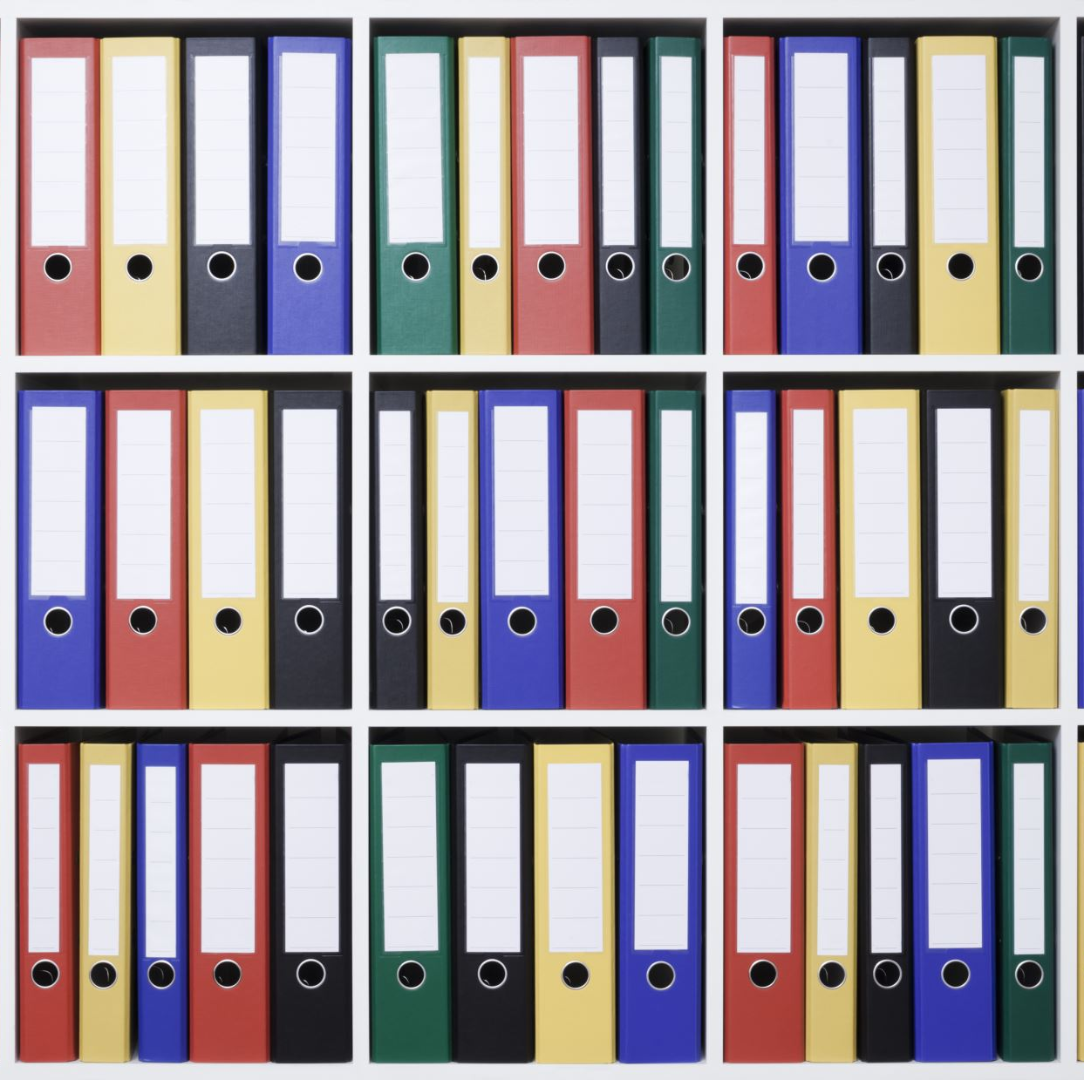
Chapter outlines
General Revision Points to Consider
Specific Revision Points to Consider
Style Revisions
Evaluating the Work of Others
Proofreading and Design Evaluation

Slide 3
LEARNING OBJECTIVES
By the end of this section, you will be able to:
1. Discuss the process of revision
2. List three general elements of every document that require revision
3. List six specific elements of every document to check for revision
4. Discuss and demonstrate the use of twelve points to consider for style revisions.
5. Describe five elements of critical analysis to use in evaluating someone else’s writing.
6. Demonstrate how to deliver an evaluation constructively and respectfully.
7. Understand the difference between revising and proofreading, and how to use proofreading marks.

Slide 4
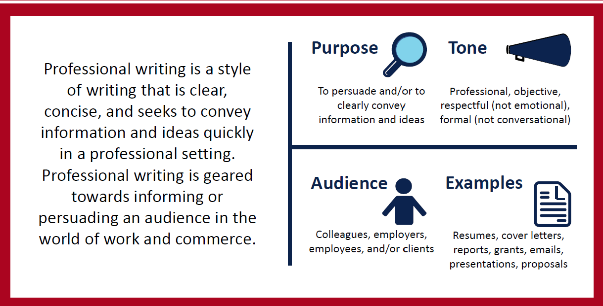
What is Professional Writing?
Notes:
Viết chuyên nghiệp là một phong cách viết rõ ràng, ngắn gọn và tìm cách truyền đạt thông tin và ý tưởng một cách nhanh chóng trong một môi trường chuyên nghiệp. Bài viết chuyên nghiệp hướng tới việc cung cấp thông tin hoặc thuyết phục khán giả trong thế giới công việc và thương mại.
How many kinds of Professional Writing ? A Lot => Study PW to work. Nhận định các thể loại PW để viết

Slide 5

Introduction
In every career, industry, and profession, today’s business climate is a results-oriented environment.
Regardless of what you write, there exists the possibility, even probability, that misunderstandings and miscommunications can and will occur.

Slide 6
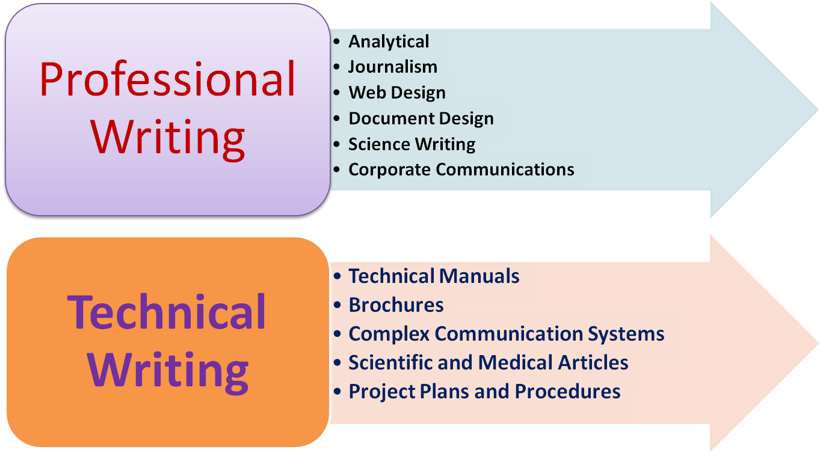
Difference of Writing types

Slide 7
1. General Revision Points to Consider
Evaluate Content
Evaluate Organization
Evaluate Style
Evaluate Readability

Slide 8

Activity
Find a particularly good example of writing according to the above criteria. Review it and share it with your classmates.

Slide 9
2. Specific Revision Points to Consider
Format
Facts
Names
Spelling
Punctuation
Grammar

Slide 10

Activity
Find an example of an error in a published document and share it with classmates.

Slide 11

3. Style Revisions
Break Up Long Sentences
Revise Big Words and Long Phrases
Evaluate Long Prepositional Phrases
Delete Repetitious Words
Eliminate Archaic Expressions or References
Avoid Fillers
Notes:
Cổ xưa

Slide 12
3. Style Revisions (Cont)
Eliminate Slang
Evaluate Clichés
Emphasize Precise Words
Evaluate Parallel Construction
Obscured Verbs
The “Is It Professional?” Test
Notes:
Ko dung từ long
Ko dung những câu tối nghĩa( vd I’ll give further information)

Slide 13

Activity
Find an example of a bad example of effective business writing, review it, and share it with your classmates.

Slide 14

4. Evaluating the Work of Others
As an experienced business writer, you may be called upon to review others’ work.
Having a clear understanding of the process will help you be efficient in your review, producing constructive advice that would benefit the essay while resisting change for change’s sake.
Notes:
1737- 28.June

Slide 15
Five Steps in EVALUATION
1. Understand the assignment.
2. Evaluate how well the writing carries out the assignment.
3. Evaluate assertions.
4. Check facts.
5. Look for errors.

Slide 16

Delivering the Evaluation
Many authors, particularly those new to the writing process, see the written word as an extension of self.
Use strategies to be tactful and diplomatic.
Avoid the use of the word “you” in your evaluation as it can put the recipient on the defensive

Slide 17

Activity
Select a piece of writing from a Web site, book, newspaper, or magazine. Imagine that you are editing it half its original length. Share the article and your revised copy with your classmates.

Slide 18

5. Proofreading and Design Evaluation
Proofreading
Design Evaluation
Framing
Typefaces
Paragraphs
Visual Aids
Designing Interactive Documents

Slide 19
KEY TAKEAWAY
The four main categories—content, organization, style, and readability—provide a template for general revision.
By revising for format, facts, names, spelling, punctuation, and grammar, you can increase your chances of correcting many common errors in your writing.
Revising for style can increase a document’s clarity, conciseness, and professionalism.
When evaluating the work of others, make sure you understand the assignment, evaluate how well the writing carries out the assignment, evaluate assertions, check facts, and watch for errors. Deliver your evaluation with tact and diplomacy.
Proofreading and design put the finishing touches on a completed document.

Slide 20
EXERCISES
Find an example of an error in a published document and share it with classmates.
Find an example of a good example of effective business writing, review it, and share it with your classmates.
With a writing assignment in draft form from your class, swap with a classmate and review the spelling, grammar, and punctuation, using proofreading marks where applicable.

Slide 21
Q&A

